Slide 1

Enhance Operational Efficiency and Safety with Comprehensive Communication Interoperability

Slide 2
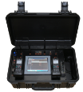
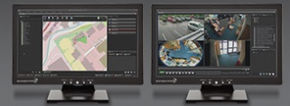
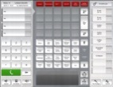


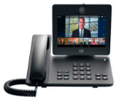
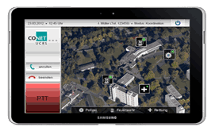
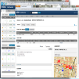
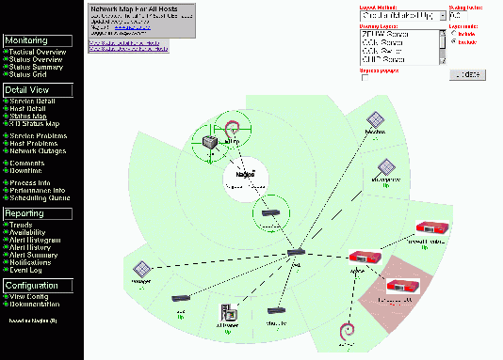










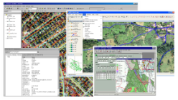
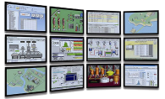
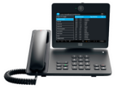
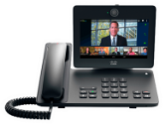
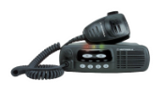



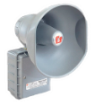
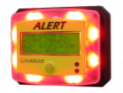




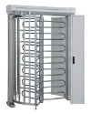





Architecture of CONET UC Radio Suite for Command & Control and Crisis Management
User
Mobile Command
Flight Case
GUI Crisis Management Workplace
Customer-specific web-based
Command & Control Dispatching GUI
Integration into 3rd Party Dispatching Solutions
Phone GUI
Mobile Apps and
Web-CAD
CONET Unified API
Backend
UCRS Management
Line based CONET TETRA /
TetraPol / LTE Gateway
Digital Analogue
Converter
CONET Multimedia
Recorder (CMR)
CONET Emergency
Call Gateway
UCRS on ISR Router/Server
CONET Unified API
Connectors
Cisco UCM - UCCE
TETRA / P25 / DMR /
UHF/VHF / LTE (4G)
Geo-Information
Traffic
Management
SCADA Integration
PSTN
Video Conference
3rd Party PBX
GSM-R
Social Media
Public Address Systems / Pager
eCall
Intercom
Drone Controller
Video
Surveillance
Voice
Recording
Physical
Security
Secure GSM

Slide 3
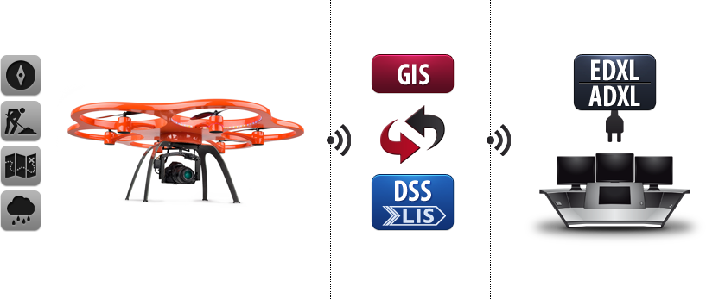
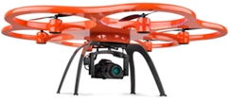
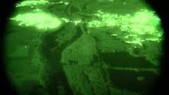



Drone - usage for Critical Communication
UCRS
Backend System
PBX, LTE, TETRA, P25, UHF/VHF, DMR
Access Point
Mobile Apps
Mobile Command Flightcase
Drone combines HD camera pictures and videos (normal and IR) with integrated sensors for temperature, weather data and other information
Drone works as wireless and radio hotspot

Slide 4
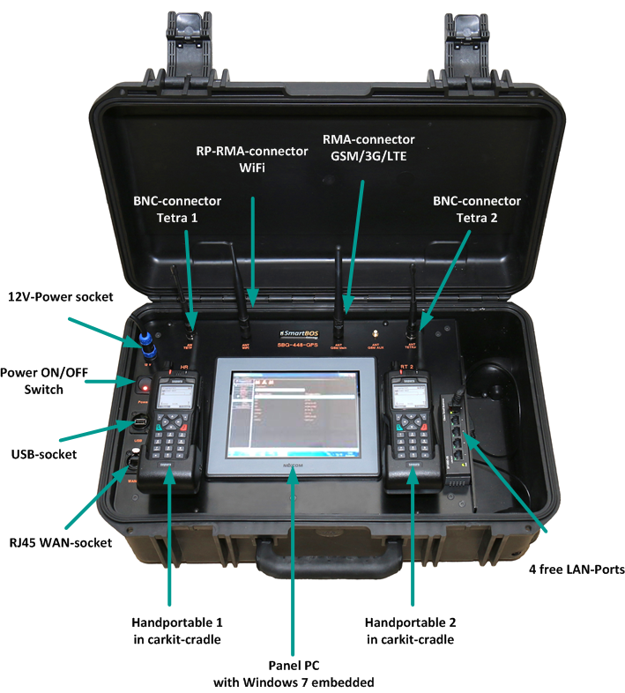
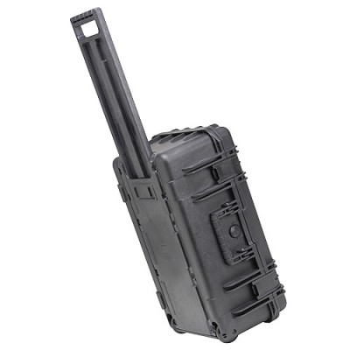
The mobile Version out of the box - CONET Mobile Command Flight Case
Mobile communication
for crisis control without borders at every scene!

Slide 5
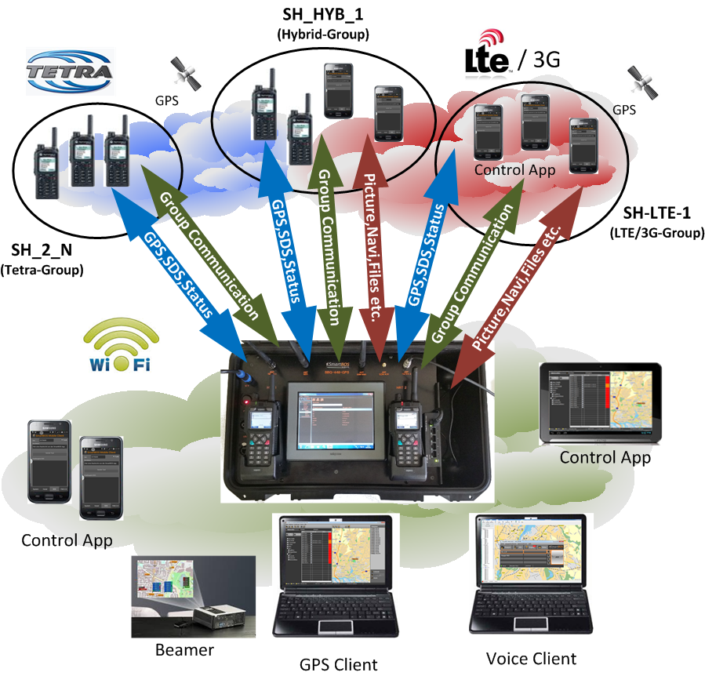
SmartBOS – Mobile Command Flight Case
CONET radio-hybrid-technology
GPS (SDS) localization of TETRA and 3G / 4 G end devices
Integration of 4G / LTE and WLAN based communication into TETRA group communication
Operation segment and operational overview
Dispatch clients and mobile devices connected via WLAN
Mobile Commander App including PTT for Android and iOS

Slide 6
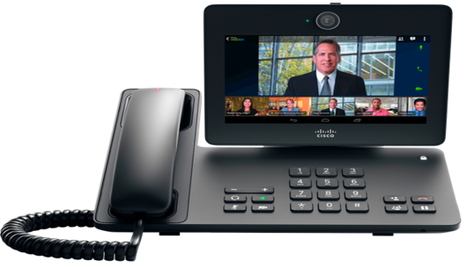

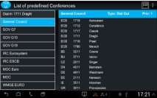
CONET UCRS Tele Conference System (TCS)
Highly secure conference functionality for large UC conferences
Integrates presence status of all conference participants
Intuitive customer specific user interface with smooth transition between telephony and conference communication
Tap-prof communication trough encryption and authentication in mobile and landline networks
Unlimited number of participants in all conference groups
Supports unlimited amount of concurrent conference groups
Integrates VoIP, LTE, analogue and digital radio (PMR, DMR, TETRA, P25) endpoints
Enables PTT mode for all kind of end devices
Enables video conferencing across multiple platforms
    Smooth handling of crisis and disaster conferences with secured communication
    Customer can predefine workflows for complex communication and crisis scenarios

